Slide 1
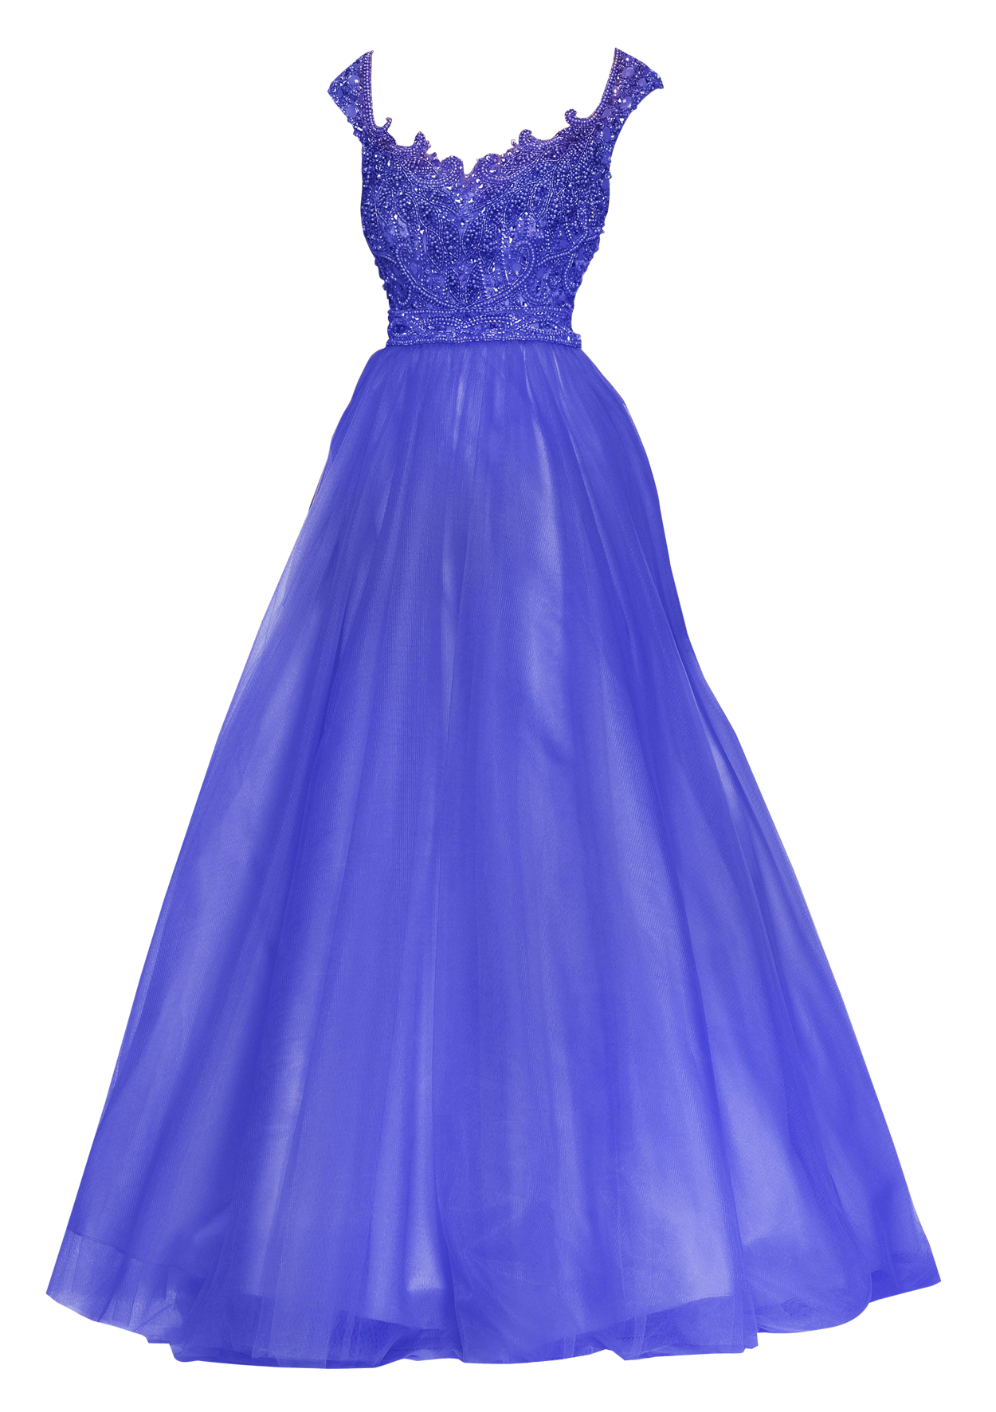
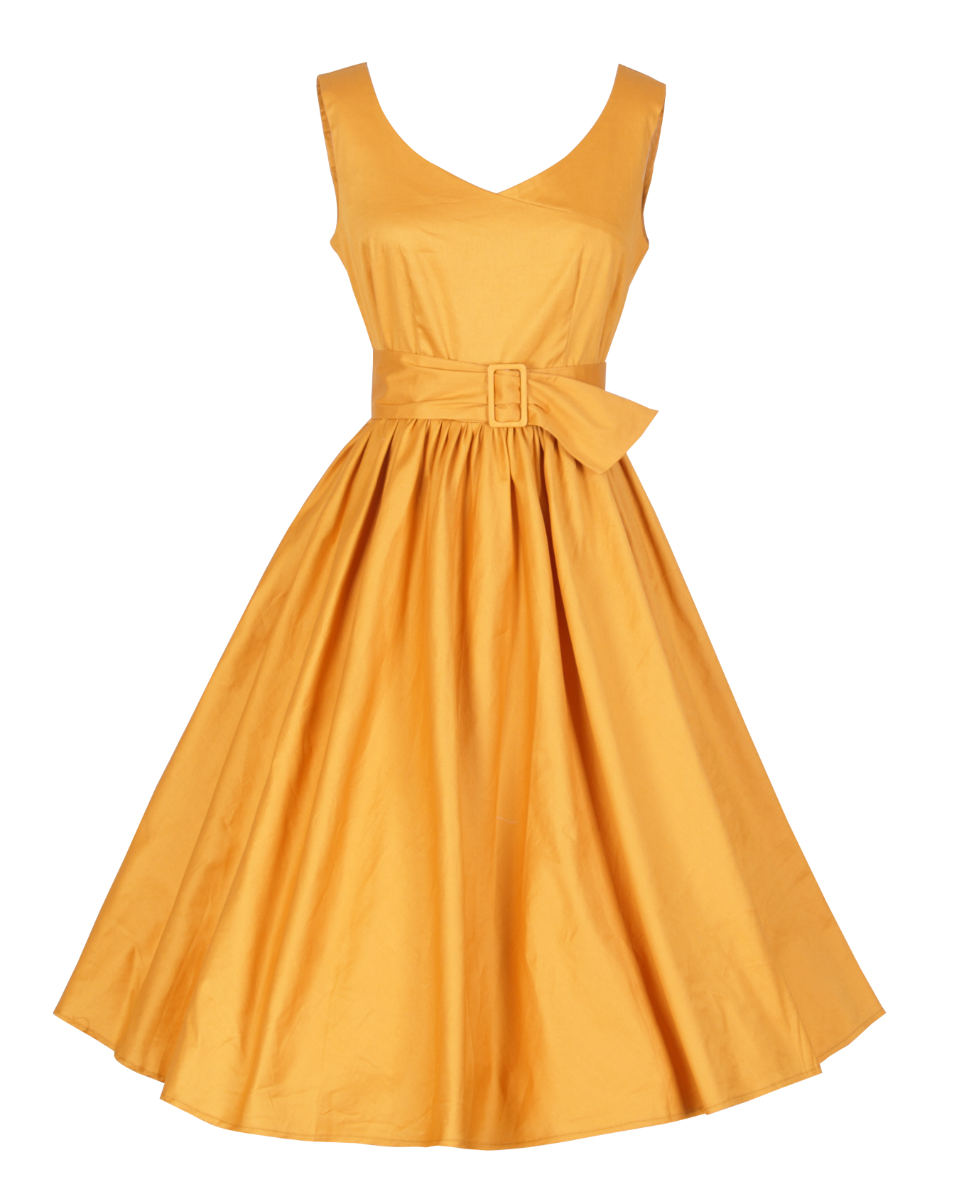
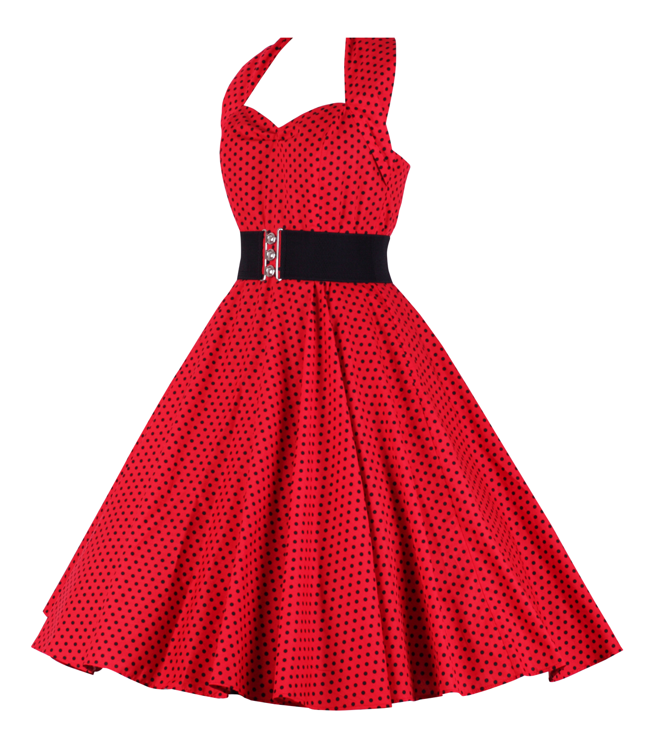
Project 1
Sofia sosa
Cop 2800
2/5/2024

Slide 2




Design
Inspired by films Lizzie McGuire and Clueless, The Fashion Show Planner application automates the management and evaluation of participants in a virtual fashion show. Participant names and their creativity scores are predefined within the program. The application calculates the average creativity score, assigns performance grades based on predetermined criteria, and displays detailed participant information. Emphasizing modular design principles, user-defined methods execute specific tasks, such as processing participant scores, calculating averages, determining performance grades, and presenting participant details

Slide 3


Overview of Concepts Implemented
Comments: Implemented both single-line and multi-line comments.
Variables and Expressions: Employed for storing participant names, creativity scores, and other data. Expressions utilized in the calculation of the average creativity score.
Varied Data Types: Numeric (double) for creativity scores and non-numeric (String) for participant names.
Operators: Involves assignment, arithmetic, relational, and logical operators.
Keyboard Input: Integrates keyboard input using the Scanner class.
Class Operations / Method Calls: Demonstrates class operations and method calls. User-defined methods, such as addParticipantScore and calculateAverageScore, encapsulate specific functionalities.
Selection / Branching: Implements branching through if-else statements for selecting performance grades based on predefined criteria.
Iteration / Looping: Incorporates iteration through participant data using a for-each loop.
Varied Parameter Lists: Utilizes varied parameter lists in user-defined methods, demonstrating flexibility in method design.
Varied Return Types: Implements varied return types in user-defined methods, including void for actions, double for calculations, and String for categorizations.

Slide 4

Types of variables used and their significance
participantScores (Map<String, Double>): Type: Map<String, Double> Significance: This data structure associates each participant's name (String) with their creativity score (Double). It serves as a central repository for participant data.
participantName (String): Type: String Significance: Represents the name of a participant. It is a parameter for addParticipantScore and displayParticipantInfo methods.
creativityScore (double): Type: double Significance: Represents the creativity score associated with a participant. It is a parameter for addParticipantScore, calculateAverageScore, determinePerformanceGrade, and used in displayParticipantInfo.
averageScore (double): Type: double Significance: Stores the calculated average creativity score of all participants. It is used in the main method and displayed using System.out.println.
sum (double): Type: double Significance: Used in calculateAverageScore to accumulate the sum of all creativity scores during the loop.
performanceGrade (String): Type: String Significance: Represents the performance grade determined based on the creativity score. Used in displayParticipantInfo.
entry (Map.Entry<String, Double>): Type: Map.Entry<String, Double> Significance: Represents an entry in the participantScores map during the iteration in displayParticipantInfo. It contains both the participant's name and creativity score.

Slide 5

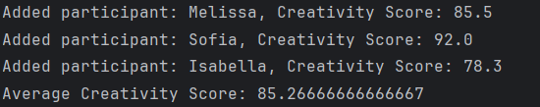
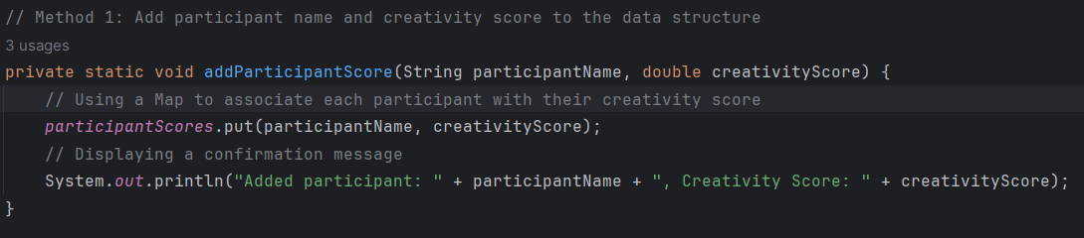
Method 1 - addParticipantScore
Method Overview:
Method Name: addParticipantScore
Return Type: void
Parameters:
participantName (Type: String)
creativityScore (Type: double)
Purpose:
Objective: Adds participant names and their associated creativity scores to the data structure (participantScores map).
How It Works: Utilizes a Map to associate each participant with their respective creativity score. Also, displays a confirmation message.

Slide 6


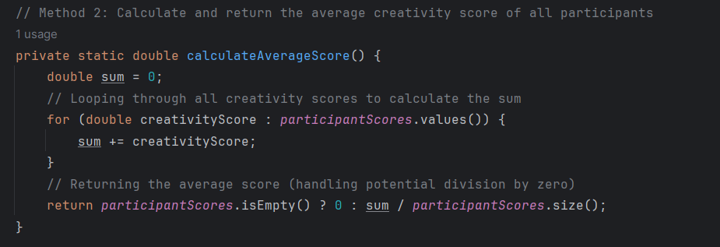
Method 2 - calculateAverageScore
Method Overview:
Method Name: calculateAverageScore
Return Type: double
Parameters: None
Purpose:
The primary objective of the calculateAverageScore method is to compute and return the average creativity score of all participants.
This method plays a crucial role in providing insights into the overall performance of participants.

Slide 7

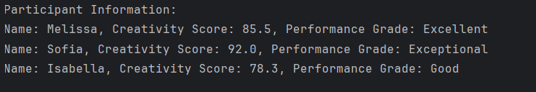
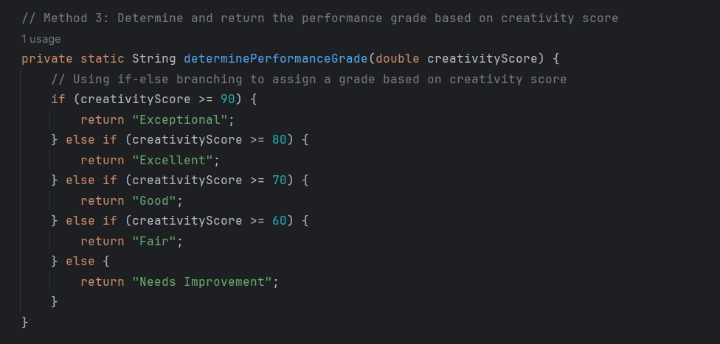
Method 3 - determinePerformanceGrade
Method Overview:
Method Name: determinePerformanceGrade
Return Type: String
Parameters: creativityScore (Type: double)
Purpose:
The primary objective of the determinePerformanceGrade method is to assess the performance grade based on a participant's creativity score.
This method contributes to categorizing participants into performance grades, adding a layer of evaluation to our Fashion Show Planner.

Slide 8

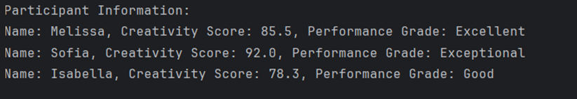
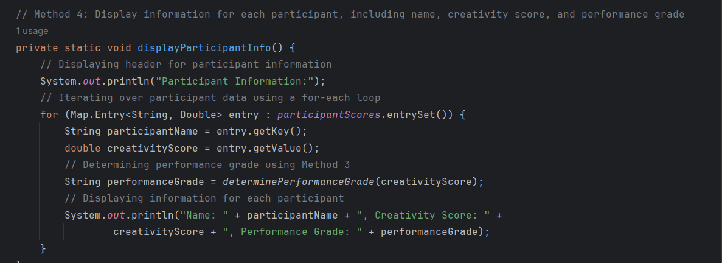
Method 4 - displayParticipantInfo
Method Overview:
Method Name: displayParticipantInfo
Return Type: void
Parameters: None
Purpose:
The central purpose of the displayParticipantInfo method is to present detailed information for each participant, encompassing their name, creativity score, and performance grade.
This method significantly contributes to the user experience, offering a comprehensive overview of participant performance.

